Slide 1


JavaScript
Sipan Sahakyan

Slide 2
What is AJAX?
AJAX = Asynchronous JavaScript And XML.
AJAX is not a programming language.
AJAX just uses a combination of:
A browser built-in XMLHttpRequest object (to request data from a web server)
JavaScript and HTML DOM (to display or use the data)

Slide 3
Ajax advantages
Update a web page without reloading the page
Request data from a server - after the page has loaded
Receive data from a server - after the page has loaded
Send data to a server - in the background

Slide 4
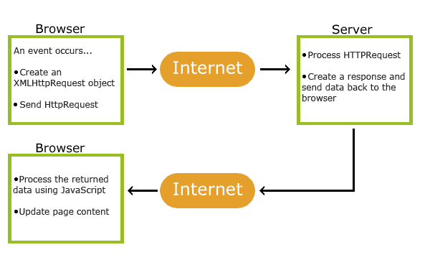
How AJAX Works

Slide 5
Callback Hell
setTimeout(() => {
console.log(10);
setTimeout(() => {
console.log(20);
setTimeout(() => {
console.log(30);
}, 1000)
}, 1000)
}, 1000)

Slide 6
XMLHttpRequest
const request = new XMLHttpRequest();
request.open('GET', 'https://restcountries.com/v3.1/name/' + countryName);
request.send();
request.addEventListener('load', () => {
console.log(request.response);
// some code after getting data from server
})

Slide 7
Promise
before future value is available
Async task has already finished
Pending
Async task
Settled
Fulfilled
Rejected

Slide 8
Promisifying setTimeout
const wait = function (seconds) {
return new Promise(function (resolve) {
setTimeout(resolve, seconds * 1000);
});
};
wait(1)
.then(() => {
console.log('1 second passed');
return wait(1);
})
.then(() => {
console.log('2 second passed');
return wait(1);
})
.then(() => console.log('3 second passed'))

Slide 9
Async / Await
async function f() {
let promise = new Promise((resolve, reject) => {
setTimeout(() => resolve("done!"), 1000)
});
let result = await promise; // wait until the promise resolves (*)
alert(result); // "done!"
}
f();

Slide 10
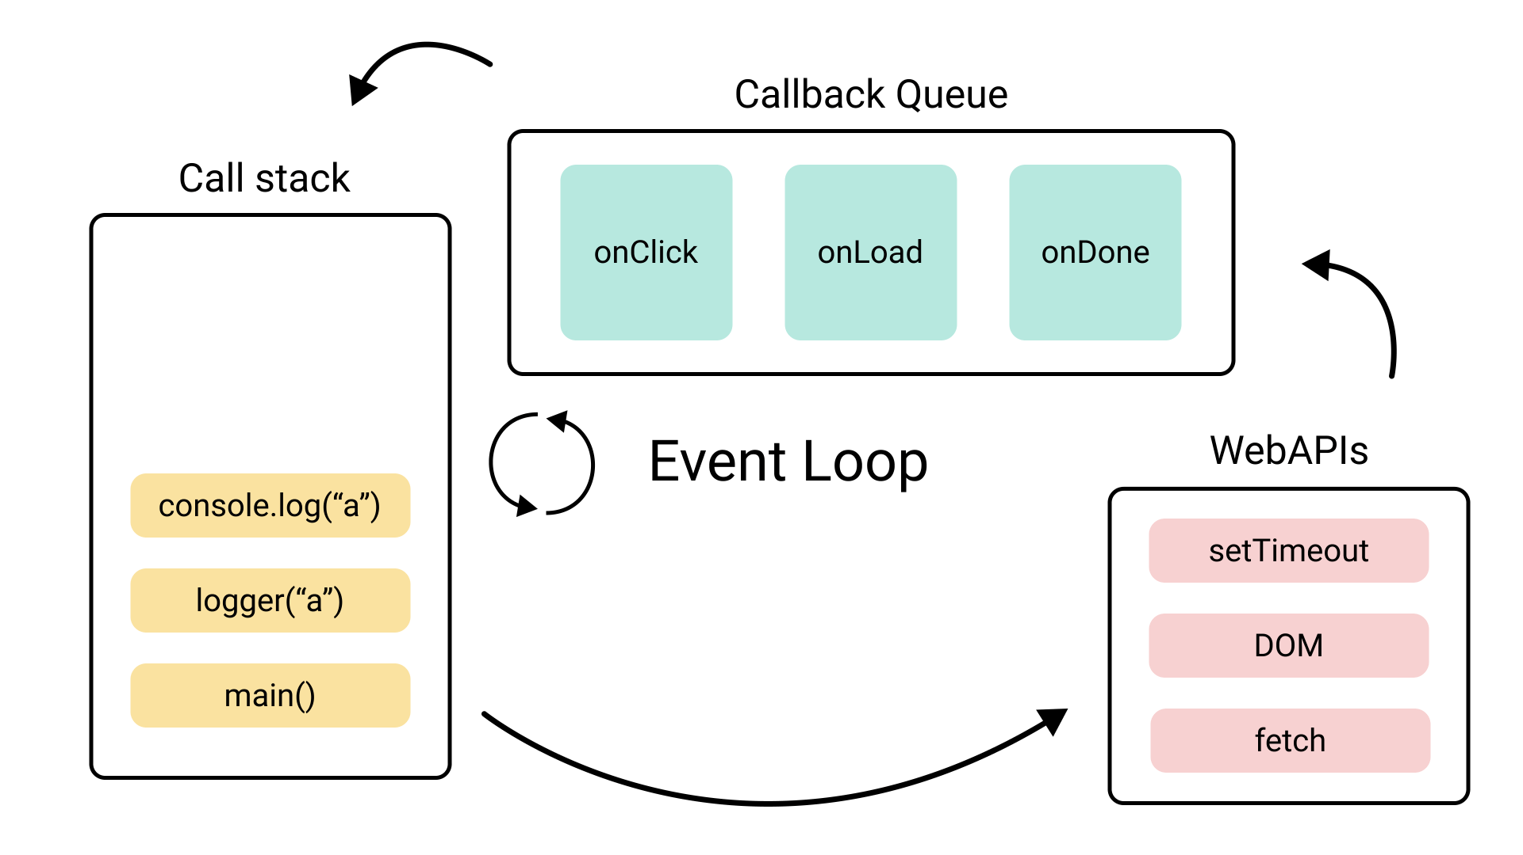
Event Loop

